Slide 1

Columbia Asia Hospital
Prateek Thakur

Slide 2
Introduction
Columbia Asia Hospital stands as a beacon of healthcare excellence, serving thousands of patients with dedication and care. The hospital’s latest performance report paints a vivid picture of its operations, shedding light on key metrics, patient satisfaction, and financial health.
The report emphasize on the following areas :
Assess the Hospital Revenue generation
Insights about the suitable departments for new hires
Strategies suggestions for patient discounts

Slide 3
Hospital Revenue Generation
In the past year, Columbia Asia Hospital has achieved remarkable growth. The total revenue has increased to ₹509.31M, a testament to the trust and reliance that patients place in the hospital's services. With 9,216 patients treated, the hospital's reach has expanded, touching lives across various demographics.
The hospital currently includes the following departments:
General Practice
Orthopedics
Physiotherapy
Cardiology
Neurology
Gastroenterology
Renal
There are 22 doctors across these departments attending to patients.

Slide 4
Insights about Departments
Appointment Fees was highest for Neurology at ₹ 1,500 per appointment, followed by Cardiology and Physiotherapy.

Slide 5
Insights about Departments
In general, the maximum wait time for patients is 60 minutes across all
departments. On average, patients experience a waiting time of 37 minutes in
Neurology department, which is notably high compared to other departments.
Department | Average Wait time(in min) | Min of Patient Wait time | Max of Patient Wait time
Neurology | 37 | 10 | 60
Physiotherapy | 37 | 10 | 60
Gastroenterology | 36 | 10 | 60
Cardiology | 35 | 10 | 60
General Practice | 35 | 10 | 60
Orthopedics | 35 | 10 | 60
Renal | 35 | 10 | 60

Slide 6
Insights about Departments
Top Revenue-Generating Departments :
Orthopedics ₹172.94M (33.96%)
General Practice: ₹164.07M (32.21%)
Other departments include Neurology, Cardiology, Physiotherapy, Gastroenterology, and Renal.
Orthopedics and General Practice are the highest earners, followed by Neurology and Cardiology.

Slide 7
Department for New Hires
Department Name | No Of Doctors | No of Patients | Total Revenue
General Practice | 3 | 7240 | ₹ 16,40,70,816.00
Orthopaedics | 4 | 995 | ₹ 17,29,39,773.00
Physiotherapy | 4 | 276 | ₹ 1,65,92,824.00
Cardiology | 3 | 248 | ₹ 6,83,70,250.00
Neurology | 3 | 193 | ₹ 7,27,95,752.00
Gastroenterology | 4 | 178 | ₹ 97,83,335.00
Renal | 3 | 86 | ₹ 47,56,367.00

Slide 8
Total Revenue by Age Group of Patients
﻿ ﻿﻿Adult(20-64) had the highest Total Revenue at ₹ 29,09,74,321.00, followed by Senior(>64), Child(0-12), and Teenager(13-19).﻿﻿ ﻿﻿
﻿﻿Adult(20-64) accounted for 57.13% of Total Revenue.﻿﻿ ﻿﻿ ﻿﻿
Across all 4 Age Band, Total Revenue ranged from ₹ 4,98,63,457.00 to ₹ 29,09,74,321.00.﻿﻿ ﻿

Slide 9
Trend In Patients visits throughout Year
Total No of Patient trended down, resulting in a 4.68% decrease between January 2019 and December 2019.

Slide 10
Strategies for patient discount
Taking into account that patients of the White race, aged between 20 and 64 years, are the most frequent visitors, it might be beneficial to contemplate providing discounts or loyalty programs for these patients. Such initiatives can contribute to improved patient retention and satisfaction.
As an alternative approach, the hospital could consider implementing periodic discounts or promotions, particularly during specific seasons or months, such as from January to March and November to December. This seasonal strategy has the potential to attract more patients and boost engagement during these months.

Slide 11
Strategies to Provide Discounts to the Patients
Below are few strategies to provide the discounts to the patients:
Offer discounts to patients who settle their bills promptly or within a specified time frame. This can encourage timely payments and improve cash flow.
Introduce bundled packages for specific services or treatments at a discounted rate. This provides value to patients and encourages them to Columbia Asia Hospital Data Analysis choose comprehensive care options.
Consider offering discounts or loyalty programs for patients who frequently visit the hospital. This can enhance patient retention and satisfaction.
Provide special discounts for senior citizens, acknowledging their healthcare needs and promoting loyalty among this demographic.
Create a referral program where existing patients who refer new patients receive discounts on future services. This can help in patient acquisition and retention.

Slide 12
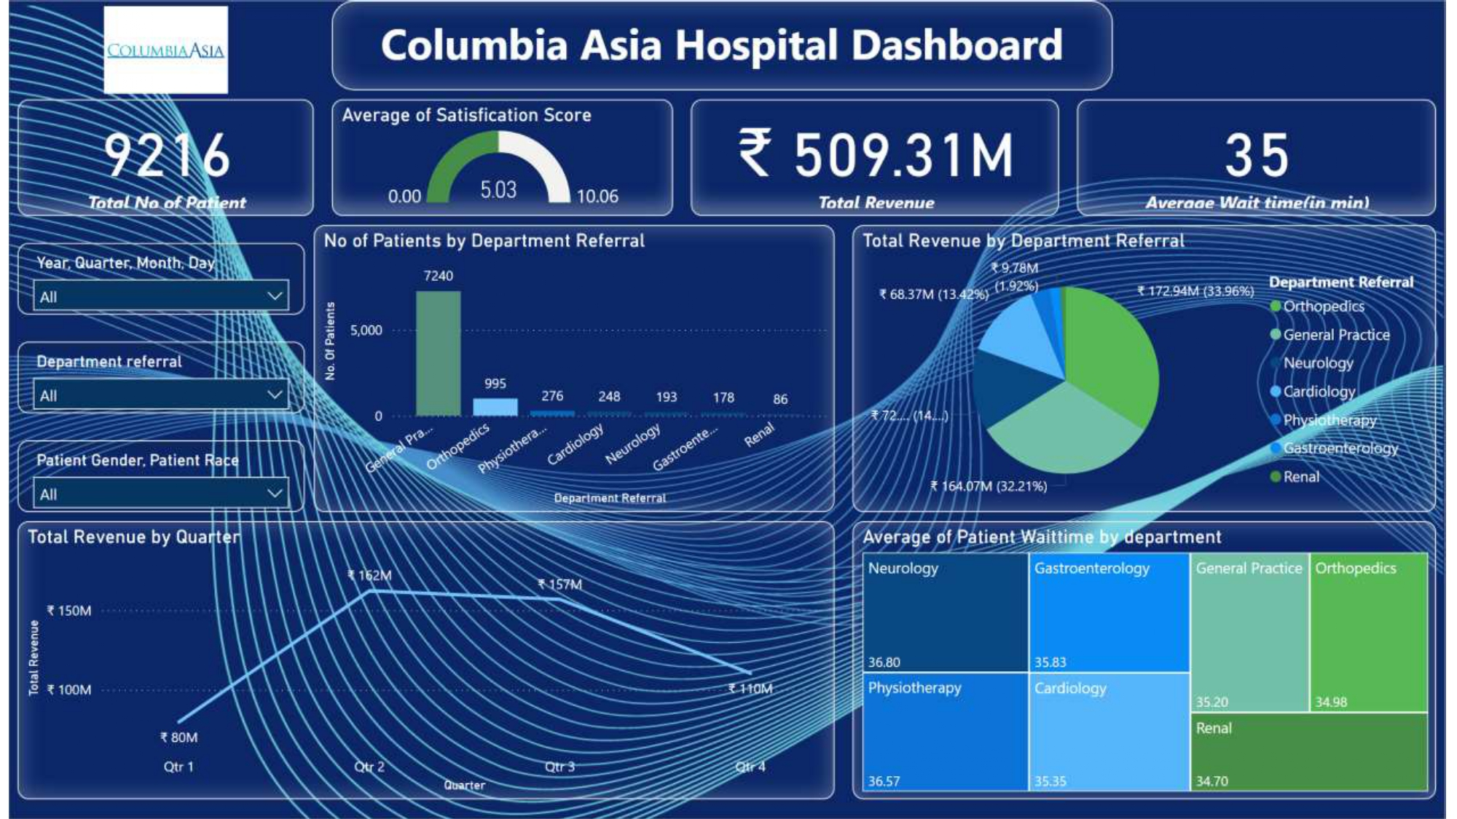
Dashboard – Main Page

Slide 13
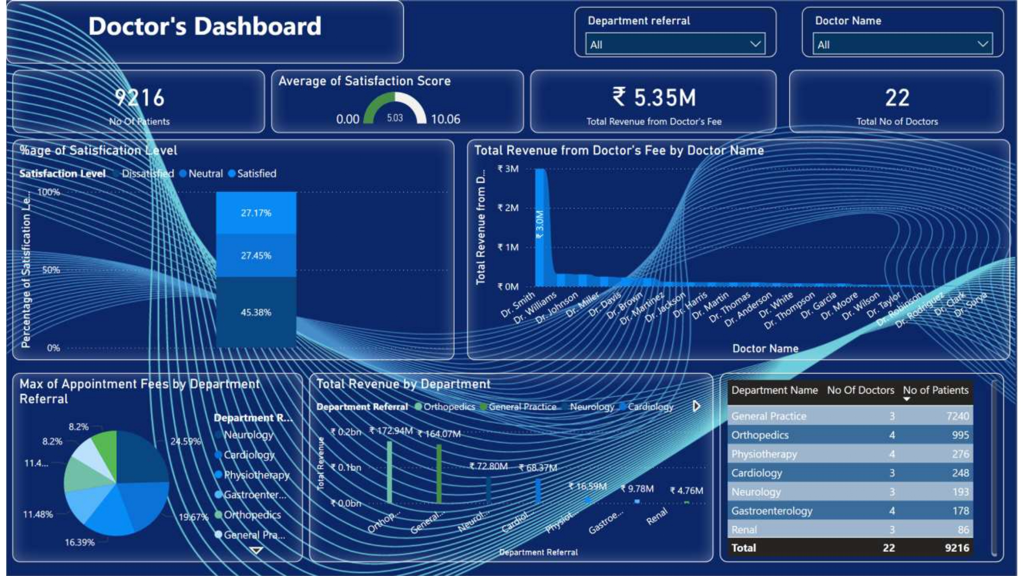
Dashboard - Doctor’s Page

Slide 14
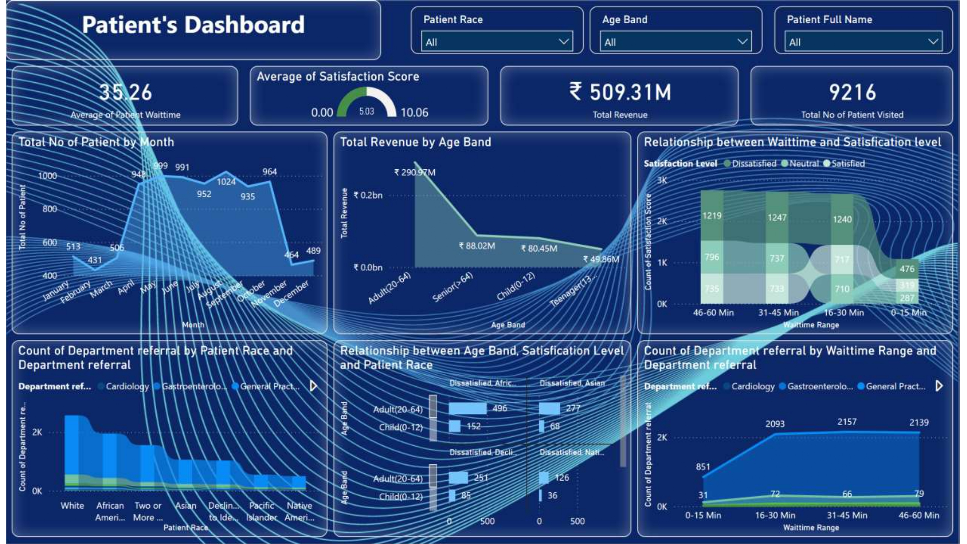
Dashboard – Patient Page

Slide 15
Thank You!

